Slide 1
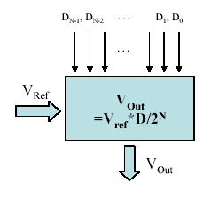
What is a DAC?
A digital to analog converter (DAC) is a device that converts digital numbers (binary) into an analog voltage or current output.
1001
0101
0011
0111
1001
1010
1011
DAC

Slide 2
Types of DAC Circuits
1. Resistor String
2. Binary Weighted Resistor
3. R-2R Ladder

Slide 3
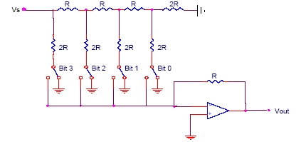
R-2R Resistor Ladder DAC
V_{ref}
Each bit controls a switch between
ground and the inverting input of the
op amp.
The switch is connected to ground if
the corresponding bit is zero.
0
0
0
0
4 bit converter
Simplest type of DAC
Requires only two precision resistance valuce (R and 2R)

Slide 4
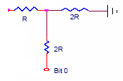
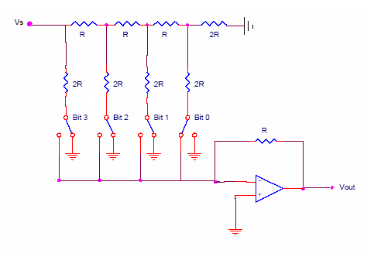

R-2R DAC Example
Convert 0001 to analog
V₁
V₀
V₃
V₂
V₁
V₀
=
V₁
V₀
V_{ref}

Slide 5
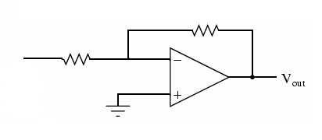
R-2R DAC Example
Convert 0001 to analog
R
2R
V_{ref}
V₀

Slide 6
R-2R DAC Summary
Conversion results for each bit
Conversion equation for N-bit DAC
Digital bit | Analog Conversion
0001
0010
0100
1000
for

Slide 7
R-2R DAC Summary
Advantages
Only two resistor values
Does not need the kind of precision as Binary weighted DACs
Easy to manufacture
Faster response time
Disadvantages
More confusing analysis

Slide 8
Specification of DAC
Resolution
Speed
Settling time
Linearity
Reference voltage

Slide 9
Specification - Resolution
The amount of variance in output voltage for every change of the LSB in the digital input.
How closely can we approximate the desired output signal(Higher Res. = finer detail=smaller Voltage divisions)
A common DAC has a 8 - 16 bit Resolution
N = Number of bits

